Slide 1

MediTrack
Guilherme Patrão | Guilherme Baracho | Miguel Eleutério

Slide 2
Introduction

Slide 3

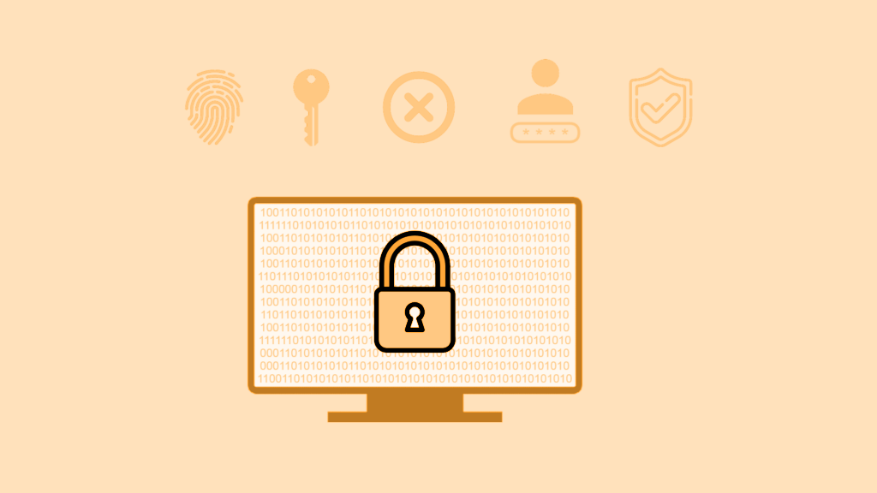
Key Features
Confidential Communication
Secure Record Authenticity
Command-line & Code Integration

Slide 4
Secure Document

Slide 5
Secure Document - Overview
Main Functionalities:
Protect: Cipher a document.
Unprotect: Decipher a document.
Check: Verify integrity of a ciphered document.
Usage Commands:
protect <input-file> <output-file> <client>
unprotect <input-file> <output-file> <client>
check <input-file> <client>
Design Considerations:
Focus on JSON handling.
Security through private key usage.
File Division:
Sections contain contents and metadata.
Contents: Encrypted or in real format.
Metadata: Key and IV encrypted with user’s public key.

Slide 6
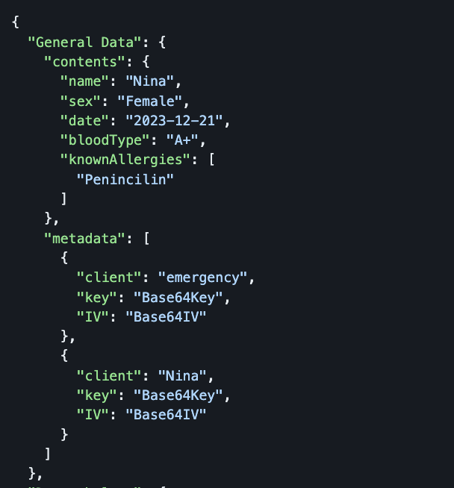
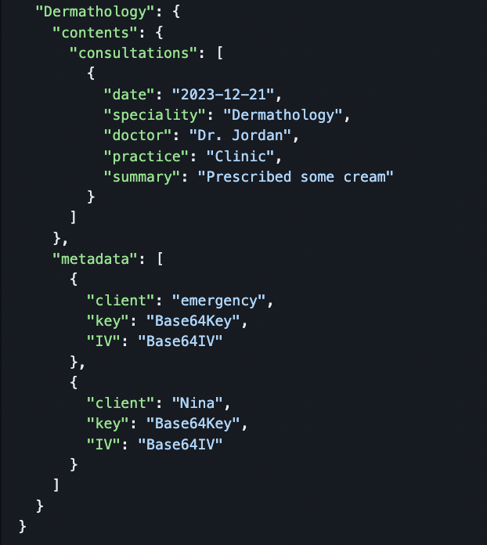
Secure Document - JSON Format

Slide 7

Secure Document - Implementation
Algorithms:
Symmetric encryption - AES/GCM w/ 128 bits key
Asymmetric encryption - RSA w/ 2048 bits key
Libraries Used:
JSON Handling: com.google.gson
Encryption/Decryption: javax.crypto
Key Handling: java.security

Slide 8
Infrastructure

Slide 9
Application Infrastructure
Client Application
Application Server
Database

Slide 10
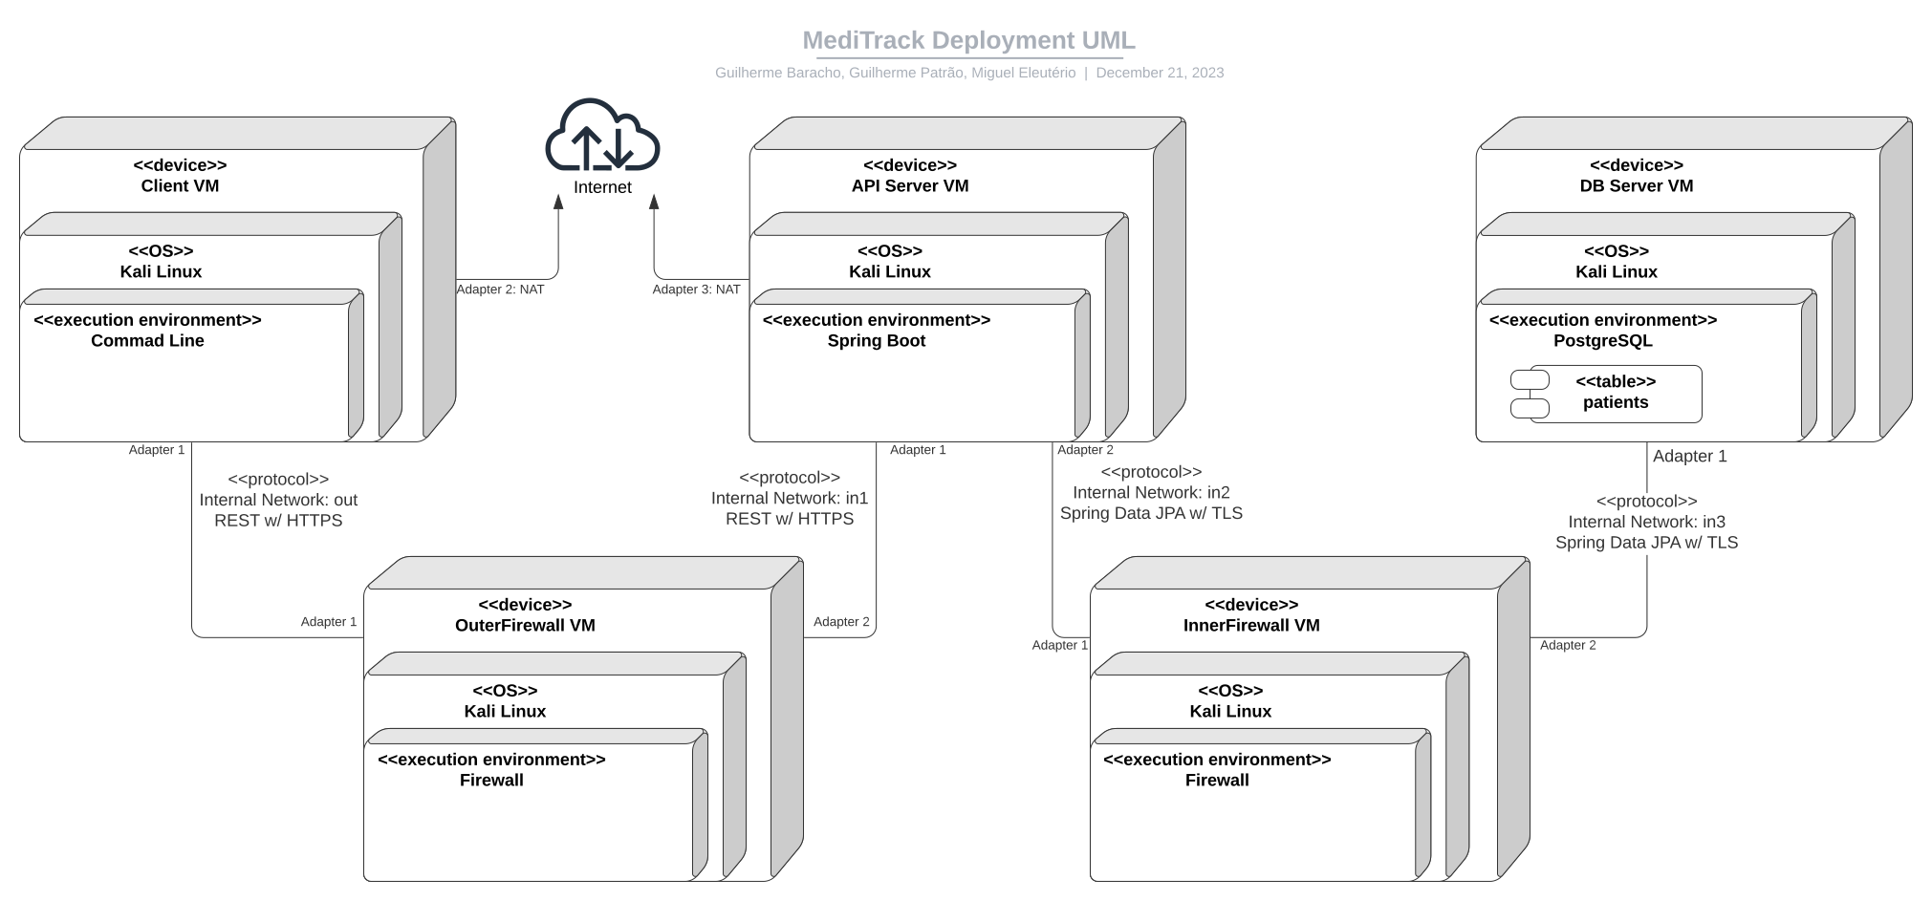
Infrastructure
Notes:
Let’s talk about the infrastructure, secure channels and key distribution.
The infrastructure consists of 5 different machines: Client, API, DB and 2 Firewalls.
The communication between the Client and API machines is done using REST with the HTTPS protocol keeping all the communications confidencial.
For the https protocol to work we had to create our own self signed certificate, and place it manually both on the Client and API machines so that we could import it into java to use avoiding allowing all self signed certificates.
Obviously for the real world application of this solution we would need to get a certificate signed by a certified entity to ensure security.
The messages sent by the Client also have in its metadata a UUID to prevent message replication and a signature to ensure that the message sent wasn’t tampered with
Communications between API and DB are made using postgres and spring-boot TLS connection which in our case was already enabled in the postgres server, which already had its own certificate, guaranteeing the confidentiality of this channel.
Each of the channels mentioned above has a Firewall in the middle which both handles the management of incoming packets and the routing of those packets to the right destination servers.
All communications made from the Client to the API and from the API to the DB are actually directed to the respective firewall and then routed to the API or DB respectively.
Regarding key distribution, all the asymmetric keys are placed in the respective machines by a sysadmin, for testing purposes we create a folder called meditrack that represents a keycard containing all the public keys and the private key f the person the card would belong to.
The symmetric keys used to encrypt the content of the documents are shared as metadata of the document, where they are encrypted with the public key of the users that are authorized to use that symmetric
.

Slide 11
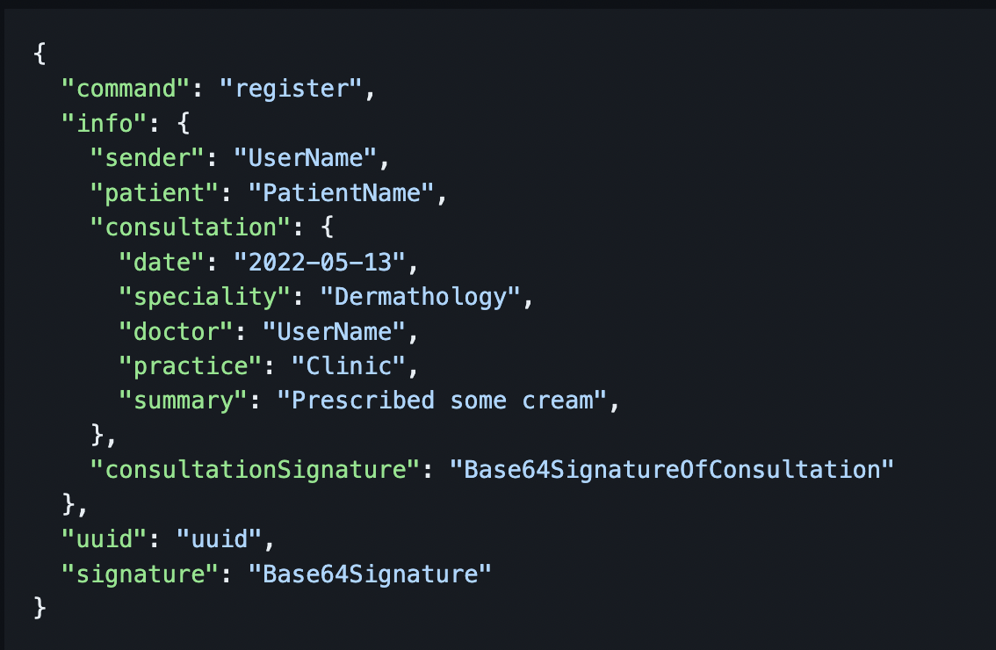
Secure Channels - Request Format

Slide 12
Security Challenge

Slide 13
Security Challenge
Challenges:
Non-repudiable Doctor Signatures
Controlled Sharing Implementation
Solutions:
Consultation Signature Verification
Section-wise Document Access Control

Slide 14
Live Demo

Slide 15
Conclusion

Slide 16
Achievements
Fully functional system from scratch
Real-world Infrastructure Emulation
Key Focus Areas:
Infrastructure & Network Setup
Data Storage & Security

